Slide 1


Slide 3


Slide 5


Slide 6
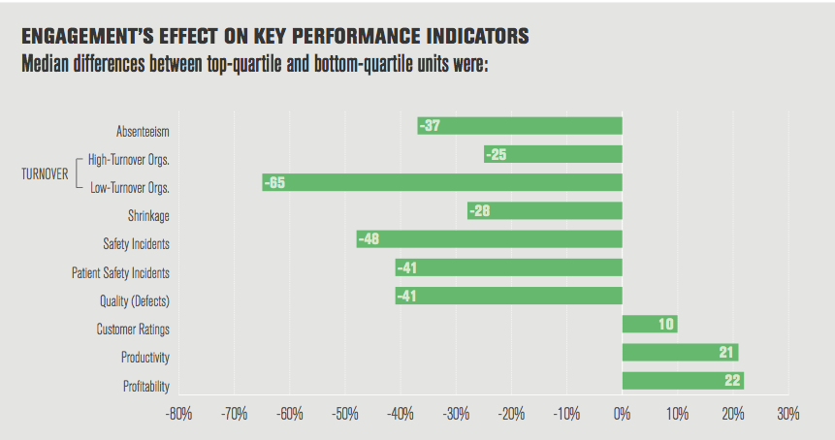

Slide 7


Slide 8
Any questions??

Slide 9
Thank you my great audience

Slide 10
Refrences :
Gal resarch.
American work place.
Canadian center.
https://youtu.be/ua4Q7zYlaX8.
Wikipedia.

